Slide 1



RabbitMQ
Integration
Spring Boot
Crash Course

Slide 2
Course Overview
We are going to install RabbitMQ on Windows
Discuss Basic Terminologies of RabbitMQ
Discuss Basic Architecture of RabbitMQ
Practically Create Exchange and Queue
Publish and Consume Message
Create A Spring Boot App and Do Necessary Configuration to connect with Rabbit MQ
Develop Producer and Consumer
Publish message and consume

Slide 3
Install RabbitMQ And ERLang and Configure
Rabbit MQ :- link Installing on Windows — RabbitMQ
Erlang link :- Downloads - Erlang/OTP
Set Up Environment Variable for Erlang
Go to RabbitMQ Server install Directory C:\Program Files\RabbitMQ Server\rabbitmq_server\sbin
--Run command rabbitmq-plugins enable rabbitmq_management

Slide 4
What is Rabbit MQ
RabbitMQ is a message broker: it accepts and forwards messages. You can think about it as a post office: when you put the mail that you want posting in a post box, you can be sure that the letter carrier will eventually deliver the mail to your recipient. In this analogy, RabbitMQ is a post box, a post office, and a letter carrier.
The major difference between RabbitMQ and the post office is that it doesn't deal with paper, instead it accepts, stores, and forwards binary blobs of data ‒ messages

Slide 5
Basic Terminologies
Message
Producer/Publisher
Consumer/Subscriber
Exchange
Binding
Routing Key
Queue

Slide 6
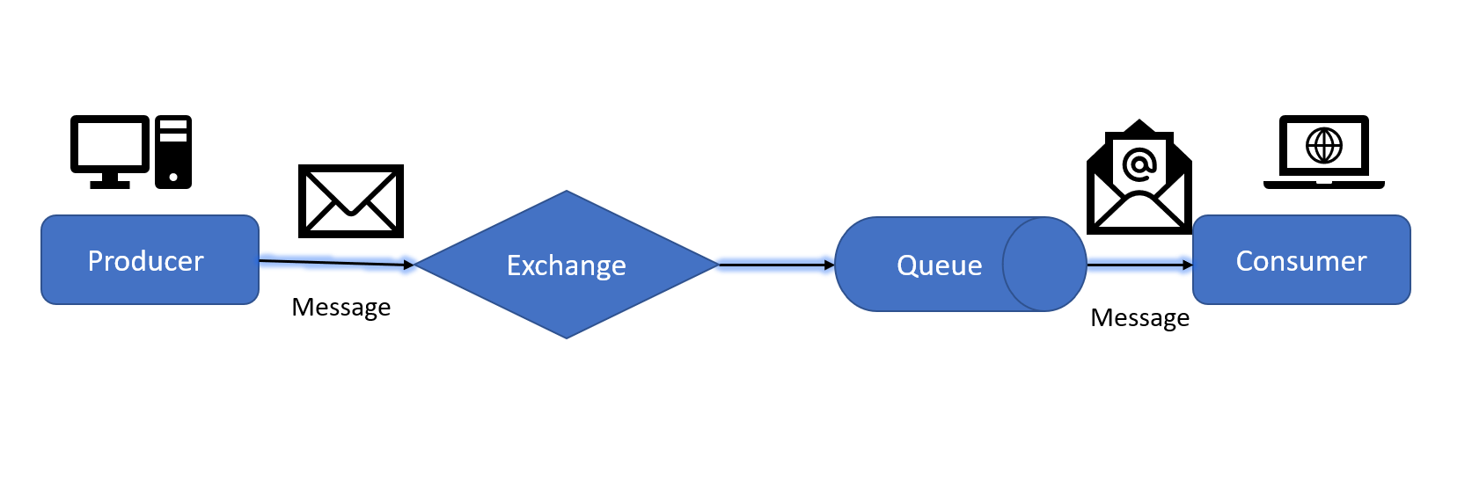
Producer
A producer is a user application that sends messages.

Slide 7
Consumer
A consumer is a user application that receives messages.

Slide 8
Exchange
The producer can only send messages to an exchange. An exchange is a very simple thing. On one side it receives messages from producers and on the other side it pushes them to queues. The exchange must know exactly what to do with a message it receives. Should it be appended to a particular queue? Should it be appended to many queues? Or should it get discarded. The rules for that are defined by the exchange type.
There are a few exchange types available: direct, topic, headers and fanout.

Slide 9
Queue
A queue is a buffer that stores messages

Slide 10
Binding
Now we need to tell the exchange to send messages to our queue. That relationship between exchange and a queue is called a binding.

Slide 11
Routing Key
It’s a key that tell exchange exactly to which queue the message should be send .
Routing Key

Slide 12




Basic Working
Exchange
Producer
Queue
Consumer
Message
Message

Slide 13
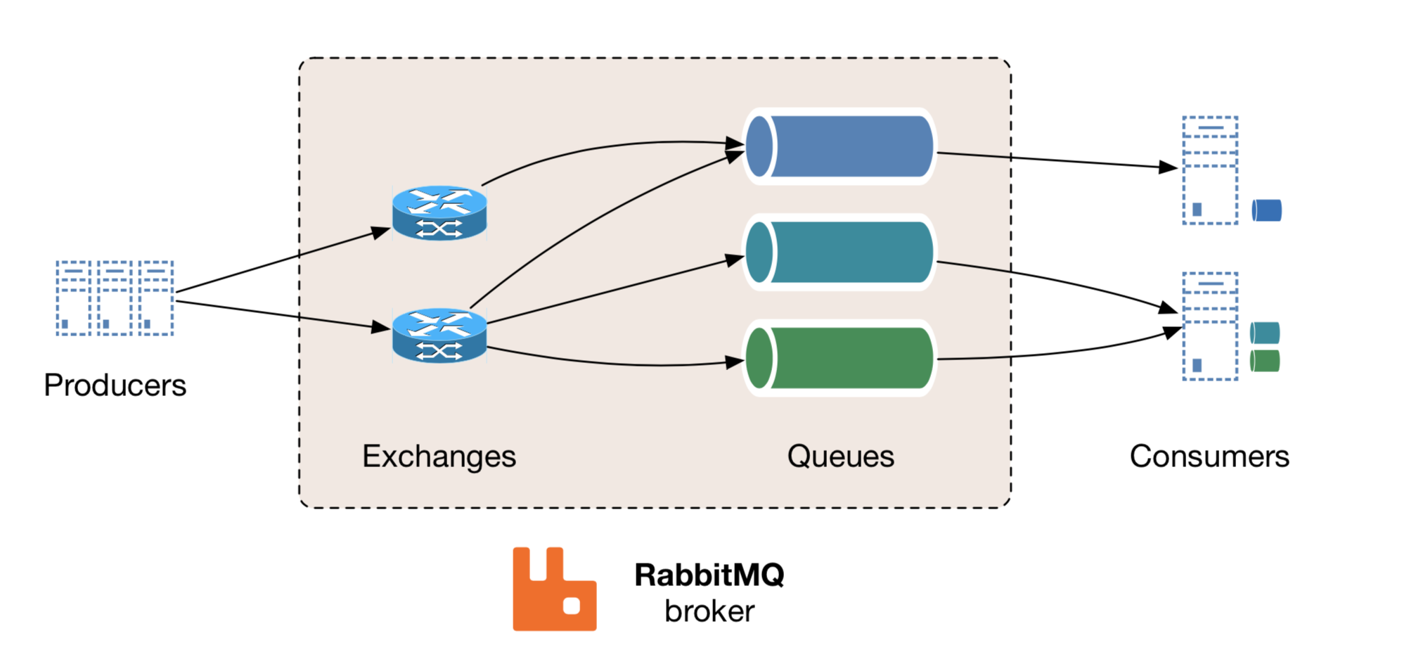
Basic Architecture

Slide 14
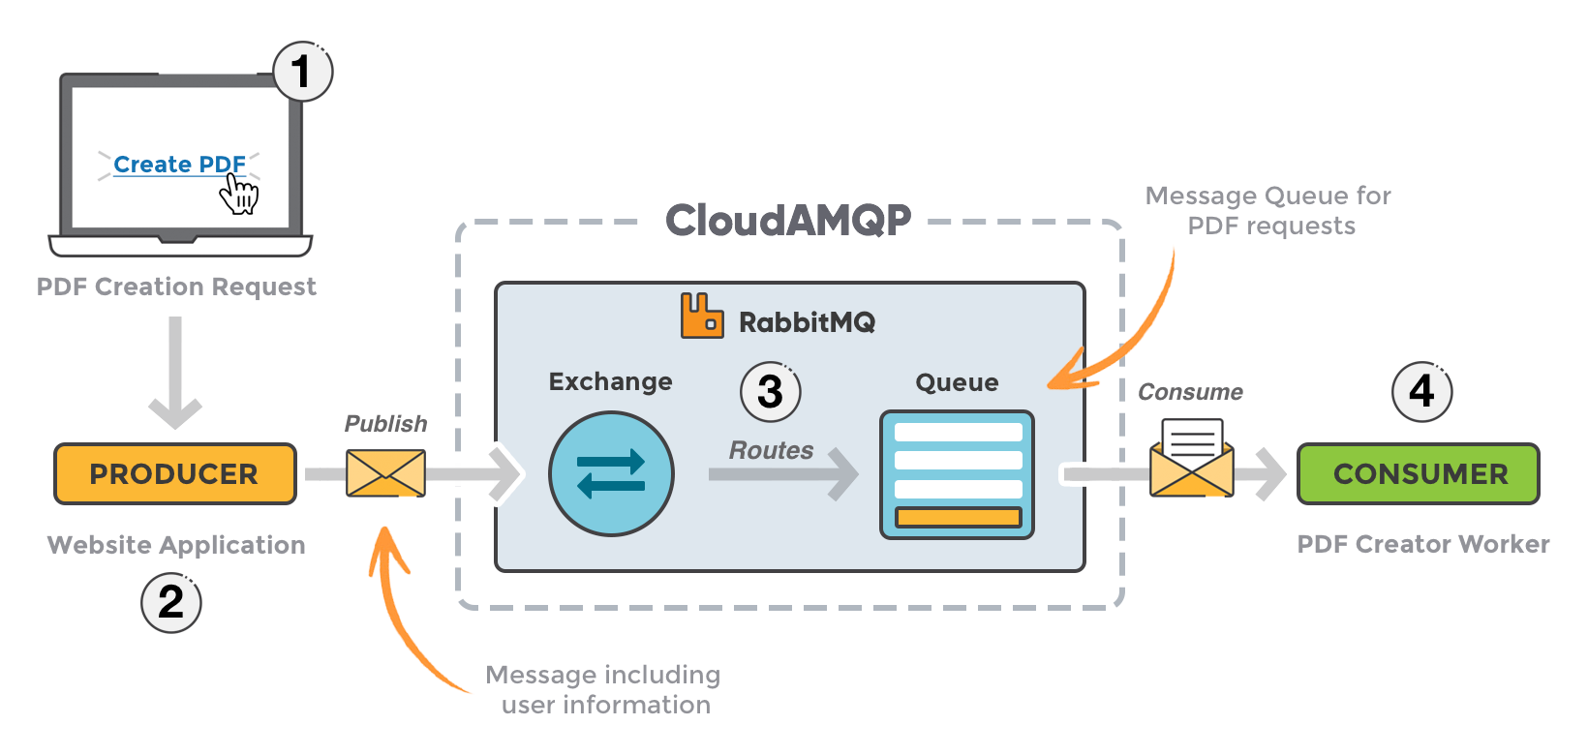
Architecture

